Slide 1


Department of Computer Science and Engineering
GE19612-Professional Readiness for Innovation,Employability and Entrepreneurship
FAKE SOCIAL PROFILE DETECTION
SYSTEM USING MACHINE
LEARNING
Muhammed Jazil
210701168
Nandhakumar S
210701172
Pragadeeshwaran S
210701190
Dr . K.Ananthajothi M.E.,Ph.D.,
Professor

Slide 2
Abstract
This project develops a system to detect fake social media profiles using machine learning. By analyzing user behaviour, posting patterns, and interactions, the system identifies suspicious accounts. It uses machine learning to securely verify identities and ensure data integrity. A user-friendly interface allows people to authenticate their profiles, while law enforcement can access tools to investigate cybercrimes. The machine learning models are continuously updated with new data to keep up with evolving fraudulent tactics. This approach helps reduce fake profiles, creating a safer online environment and supporting cybercrime prevention efforts.

Slide 3
Existing System
In the early days of social media, detecting fake profiles primarily relied on manual moderation and user reporting. Moderators reviewed profiles for inconsistent information, generic or poor-quality photos, and unusual activity patterns, such as rapid friend requests or mass messaging. Basic pattern recognition was employed to identify repetitive text and spammy behaviour. IP address monitoring flagged geographical inconsistencies and multiple accounts from a single IP. Simple keyword filters and Captcha verifications helped prevent automated sign-ups. Analysing network connections and engagement quality also played a role in identifying fake profiles. These methods were less sophisticated but laid the groundwork for modern detection techniques.

Slide 4
Proposed System
A proposed system for detecting fake social media profiles using a Random Forest algorithm involves training the model on labelled data featuring genuine and fake profiles. Key features include profile information (age, bio completeness), behavioural patterns (posting frequency, activity timing), network characteristics (friend/follower ratios), and content analysis (text sentiment, linguistic cues). The Random Forest model, known for its robustness and accuracy, processes these features to classify profiles. The system continuously updates with new data to improve detection. This hybrid approach, combining automated detection with periodic manual review, enhances the accuracy and reliability of identifying fake profiles.

Slide 5
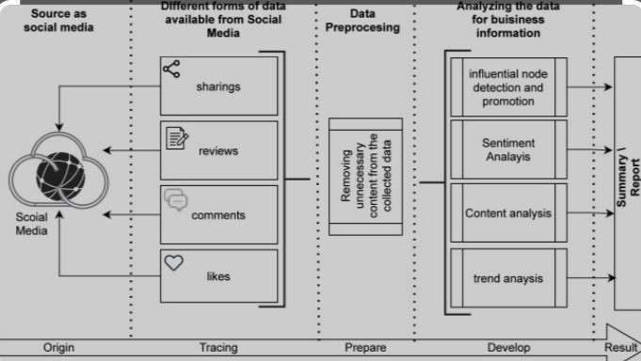
System Architecture

Slide 6
Random Forest Algorithm
1. Ensemble Learning
The Random Forest algorithm combines multiple decision trees to improve the accuracy and robustness of the model.
2. Feature Importance
The algorithm can identify the most
influential features in the classification
process, helping to understand the key indicators of fake accounts.
3. Handling Imbalanced Data
Random Forest is well-suited for handling imbalanced datasets, which is common in the context of fake account detection.
4. Interpretability
The decision tree-based nature of Random
Forest allows for better interpretability of
the model's predictions.

Slide 7

Implementation

Slide 8
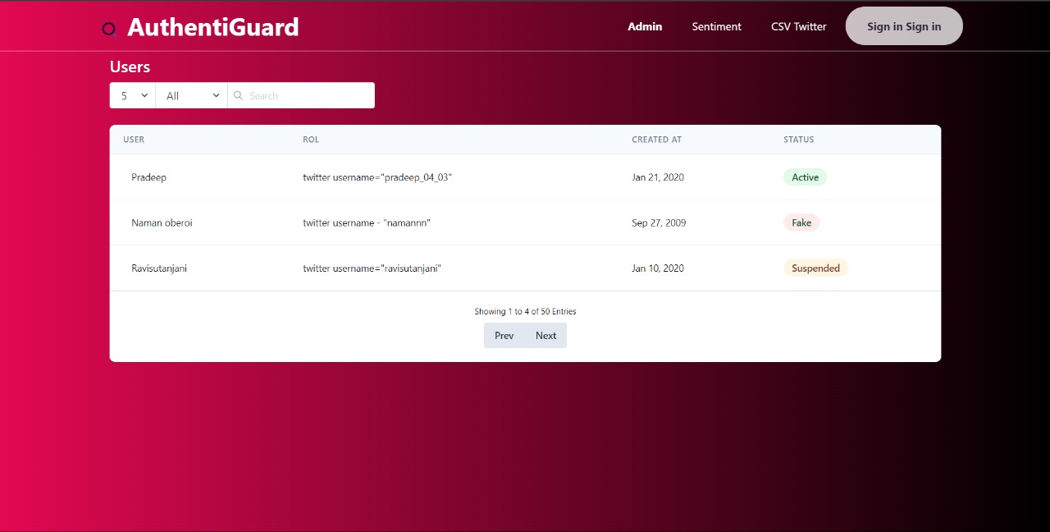
Implementation

Slide 9
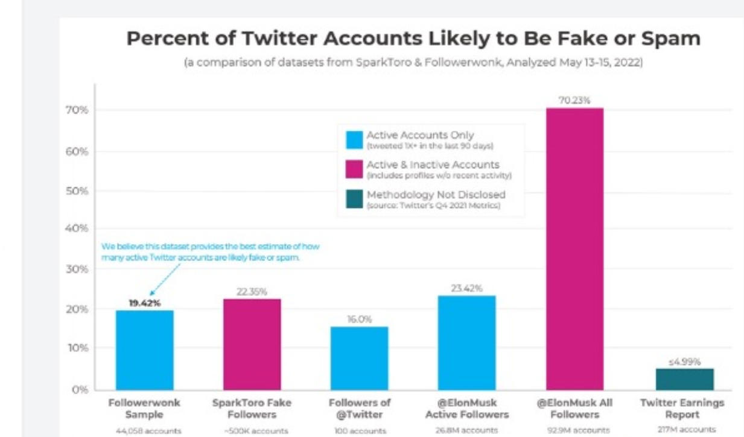
Analysis

Slide 10
Conclusion
In conclusion, the proposed system for detecting fake social media profiles using a Random Forest algorithm offers a comprehensive and effective solution to a growing problem. This model leverages a diverse array of features, including profile information (e.g., account age, bio completeness), behavioral patterns (e.g., posting frequency, activity timing), network characteristics (e.g., friend/follower ratios), and content analysis (e.g., text sentiment, linguistic cues). The Random Forest algorithm's ability to handle large datasets and its robustness against overfitting make it an ideal choice for this application.
By training the model on labeled datasets of genuine and fake profiles, it learns to identify subtle patterns and anomalies that signify fake accounts. The continuous integration of new data ensures the system remains adaptive to the evolving strategies of fake profile creators. This automated detection approach not only improves accuracy but also significantly reduces the workload on human moderators, allowing them to focus on more complex cases.
Ultimately, this system enhances the security and integrity of social media platforms, providing a safer environment for users. It fosters trust and authenticity, crucial for the sustained growth and success of social networks. Implementing this advanced machine learning solution represents a proactive step towards combating online deception and maintaining the credibility of social media interactions.

Slide 11
References
1. Ferrara, E., Varol, O., Davis, C., Menczer, F., & Flammini, A. (2016). The rise of social bots. Communications of the ACM, 59(7), 96-104.
2. Swan, M. (2015). Blockchain: Blueprint for a new economy. O'Reilly Media, Inc.
3. Jin, J., Gubbi, J., Marusic, S., & Palaniswami, M. (2018). An information framework for creating a smart city through internet of things. IEEE Internet of Things Journal, 1(2), 112-121.
4. Eyal, I., & Sirer, E. G. (2014). Majority is not enough: Bitcoin mining is vulnerable. In Proceedings of the 2014 conference on Internet measurement conference (pp. 439-454).
5. Yang, K. C., Varol, O., Davis, C. A., Ferrara, E., Flammini, A., & Menczer, F. (2019). Arming the public with artificial intelligence to counter social bots. Human Behavior and Emerging Technologies, 1(1), 48-61.

Slide 12
Thank You

